Slide 1
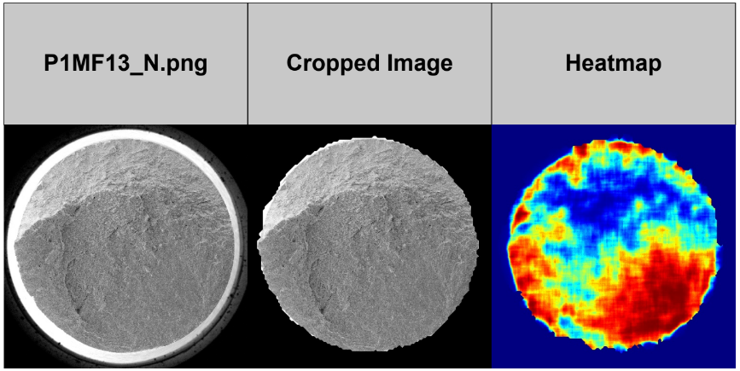
We want to know the transition from the cropped image to the heatmap

Slide 2
The first step is to make the image as grayscale: img_grey = cv2.cvtColor(img, cv2.COLOR_BGR2GRAY)
means that no matter how the image came as input, we make it as grayscale image, with pixels values ranges from 0 to 255 where 0 is black and 255 is white.
why? because it enhances computational efficiency in the next algorithms like gaussian blurring, sobel, sliding window.
The next step is blurring the image with gaussian blurring (explained deep in the next slide) technique: blur = cv2.GaussianBlur(img_grey, (13,13), 0)
(13,13) parameter is the size of the gaussian kernel, it is a tuple of (width, height).
Blurring helps to average out rapid intensity changes ensuring that only significant edges are detected, rather than random noise or small details.

Slide 3
Gaussian blurring
Lets suppose we have this section in an image:
[ [10, 20, 30, 40, 50],
[60, 70, 80, 90, 100],
[110, 120, 130, 140, 150],
[160, 170, 180, 190, 200],
[210, 220, 230, 240, 250]
]
lets say that our gaussian kernel is: [ [1, 2, 1],
[2, 4, 2],
[1, 2, 1] ]
which means that the kernel that we work with is 3x3 size (and not 13*13 as we used in our project).

Slide 4
Now lets say that we want to calculate the new pixel value at position (2,2).
So we put the kernel in (2,2) position: [
[70, 80, 90],
[120, 130, 140],
[170, 180, 190]
]
So the new value at (2,2) will be:
= (1*70 + 2*80 + 1*90) +
(2*120 + 4*130 + 2*140) +
(1*170 + 2*180 + 1*190)
= (70 + 160 + 90) +
(240 + 520 + 280) +
(170 + 360 + 190)
= 320 + 1040 + 720
= 2080

Slide 5
This outcome needs to be normalized by the sum of the kernel which is 16 so: 2080 / 16 = 130.
So, the new pixel value at position (2,2) is 130.
This simplified example demonstrates how the surrounding pixels influence the new pixel value.
This process is done on every pixel in the image, and the result is blurring because each pixel's new value is calculated as a weighted average of its surrounding pixels, according to the Gaussian kernel. This weighted averaging smooths out rapid intensity changes, reducing noise and fine details, which results in a smoother, less sharp image.

Slide 6
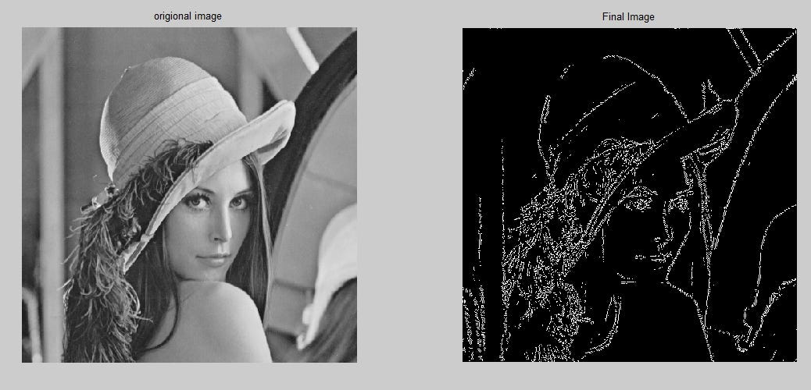
The next step is using sobel operator for detect edges in x axis and y axis: sobelx = cv2.Sobel(blur, cv2.CV_8U, 1, 0, ksize=5)
sobely = cv2.Sobel(blur, cv2.CV_8U, 0, 1, ksize=5)
The Sobel operator is an effective technique for edge detection, highlighting regions in an image where there are significant intensity changes.

Slide 7
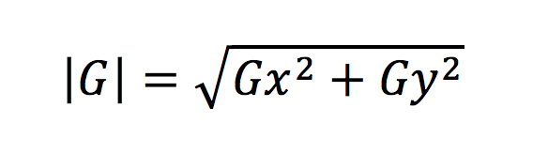
The Sobel operator is a mathematical tool used to calculate the gradient of the image intensity at each pixel. The gradient represents the rate of change of intensity, which is highest at the edges.
There is a : Horizontal Gradient (Gx): Detects vertical edges.
Vertical Gradient (Gy): Detects horizontal edges.
After applying the Gx and Gy kernels, you get two gradient images (I put example in the next slide), one for the x direction and one for the y direction.
To get the overall gradient magnitude (strength of edges) at each pixel, you combine these gradients using the formula:
sobel_magnitude = np.sqrt(sobelx**2 + sobely**2)

Slide 8
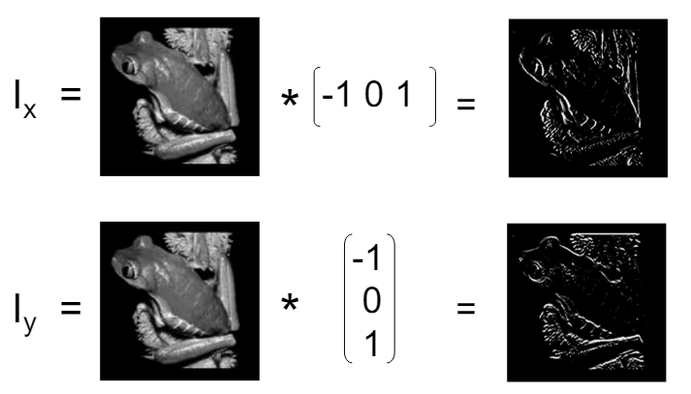

Slide 9
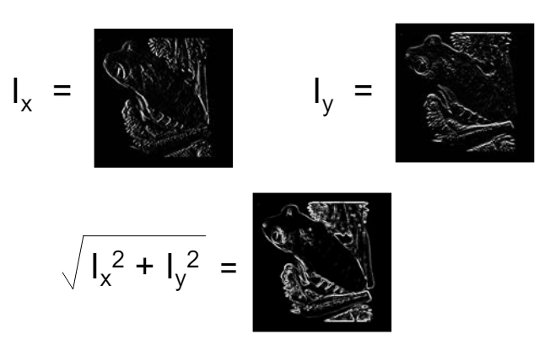

Slide 10
Then, we normalized the gradient magnitude by: sobel_magnitude = sobel_magnitude / sobel_magnitude.max() * 255
to ensure the values range between 0 and 255.

Slide 11
Sliding window
The Sliding Window Analysis is the part of the function that creates the heatmap by analyzing small, localized regions of the image. Here's how it works:
Define Parameters
Window Size: This is the size of the square window that will slide over the image. In our code, it is set to 201x201 pixels.
Step Size: This is how much the window moves each time. It is set to 10 pixels in our code, meaning the window will move 10 pixels to the right and then 10 pixels down.

Slide 12
Why do we need sliding window after applying sobel?
Sobel Operator: The Sobel operator generates edges in an image by calculating the gradient magnitude at each pixel. This process highlights areas with significant intensity changes, creating an edge map that shows where the edges are located.
Sliding Window Algorithm: The Sliding Window Algorithm further analyzes the edge map generated by the Sobel operator. It systematically examines small, localized regions (windows) of the edge map to calculate aggregated edge information (such as average gradient magnitude) within each window. This localized analysis helps create a detailed heatmap that visualizes the intensity and distribution of edges across the image.
short video that demonstrate the process of sliding window: https://www.youtube.com/watch?v=6_xsEKE_kpE from 1:30 minute to the end.

Slide 13
Histogram equalization
Histogram definition: counting how many times each intensity value (pixel) appears in the image, from black (0) to white (255).
Equalization: The technique adjusts the histogram so that each intensity value is used more evenly across the image. This helps in making details more visible.
CDF definition: The Cumulative Distribution Function (CDF) of an image histogram represents the cumulative sum of the pixel intensities.
It calculate by starting from the first intensity value (e.g., 0), add up the counts of each intensity value from the histogram until we reach the current intensity value. This is done for all intensity levels (from 0 to 255).

Slide 14
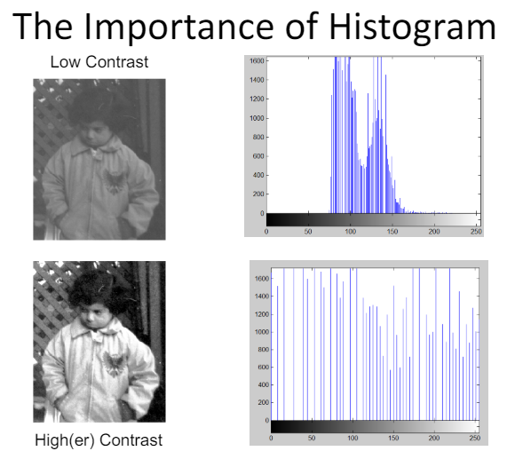

Slide 15
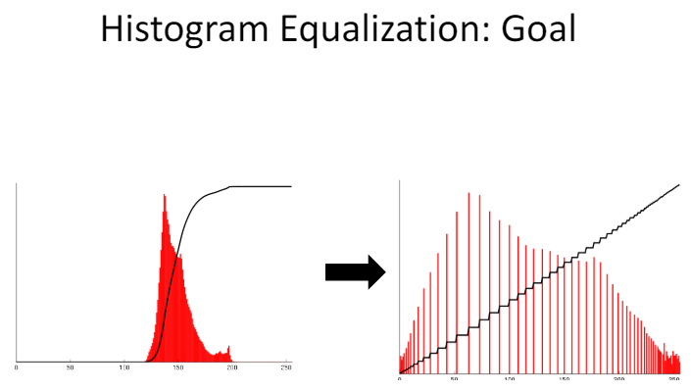
Example of CDF where the most intensity values are range between 120-200. We want that the CDF will be linear (or close to linear).

Slide 16
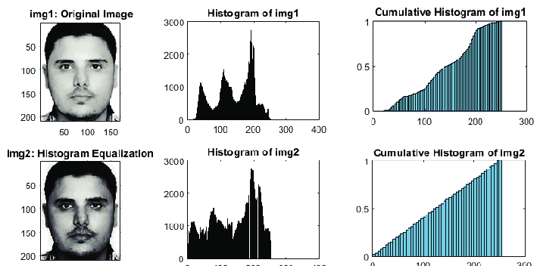
Example of histogram equalization

Slide 17
Suppose we have this small image with this pixel values : [0 1 2
3 4 5 6 7 7]
Step 1: Histogram
Intensity | frequency
0 | 1
1 | 1
2 | 1
3 | 1
4 | 1
5 | 1
6 | 1
7 | 2

Slide 18
step 2: Calculate the Cumulative Distribution Function (CDF):
intensity | CDF
0 | 1
1 | 2
2 | 3
3 | 4
4 | 5
5 | 6
6 | 7
7 | 9

Slide 19
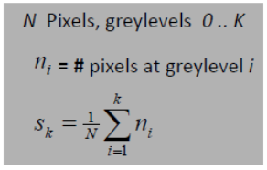
step 3: Normalize the CDF - Normalize the CDF to the range 0-255.
This is done for ensure that the pixel intensity values span the entire available range (0-255).
Sk​: The cumulative distribution function at greylevel k.

Slide 20
Example:
Suppose we have an image with a total of N = 100 pixels and the following histogram data:
Greylevel 0: 5 pixels
Greylevel 1: 15 pixels
Greylevel 2: 20 pixels
Greylevel 3: 30 pixels
Greylevel 4: 30 pixels
To compute S3​:
Sum the number of pixels from greylevel 0 to greylevel 3:
∑=5+15+20+30=70
Normalize by the total number of pixels N: S3​=70/100 = 0.7
So, S3​ means that 70% of the pixels in the image have an intensity less than or equal to 3.

Slide 21
continue
intensity(v) | CDF (cumulative sum) | Normalized CDF (0-255)
0 | 1 | 0
1 | 2 | 32
2 | 3 | 64
3 | 4 | 96
4 | 5 | 128
5 | 6 | 160
6 | 7 | 192
7 | 9 | 255

Slide 22
So final image will be: [ 0 32 64
96 128 160
192 255 255]
These steps ensure that the pixel intensities are spread across the entire range (0-255), enhancing the contrast of the image.

Slide 23
The last step is: heat_map_color_sobel = cv2.applyColorMap(heat_map_sobel, cv2.COLORMAP_JET)
which is convert the equalized grayscale image into a color-coded heatmap using a color map.
Color Mapping:
Low intensity values (e.g., 0): Mapped to blue.
Mid-range values (e.g., 128): Mapped to green.
High intensity values (e.g., 255): Mapped to red.
All other pixels are mapped to the colors between.

Slide 24
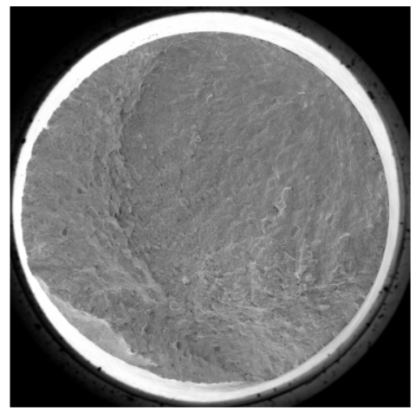
כל השלבים על התמונות שלנו
Original

Slide 25
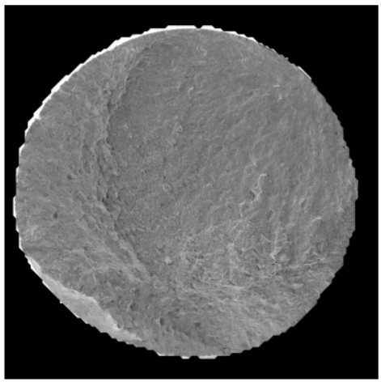
Find external contour

Slide 26
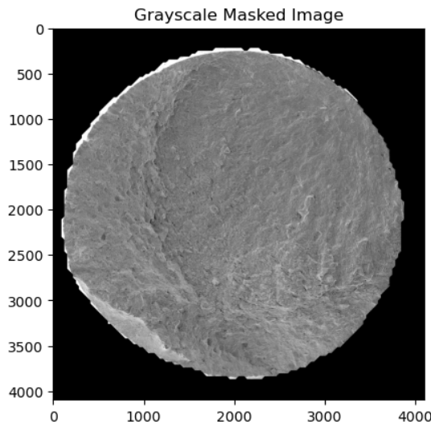
Make it as grayscale

Slide 27
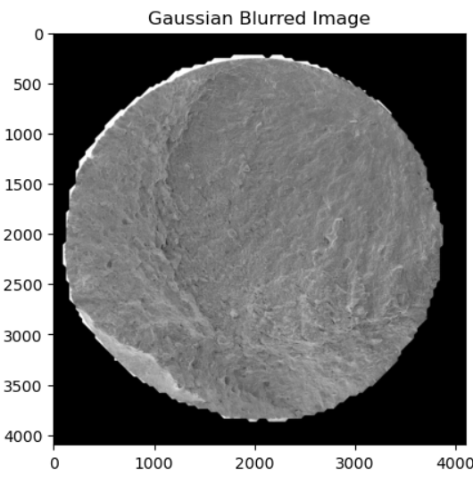
Apply Gaussian for blurring the image

Slide 28
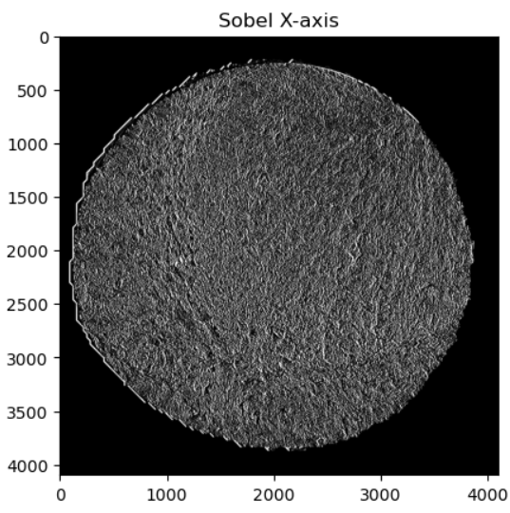
Sobel on x axis

Slide 29
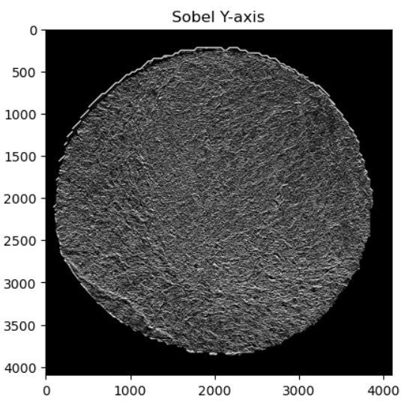
Sobel on y axis

Slide 30
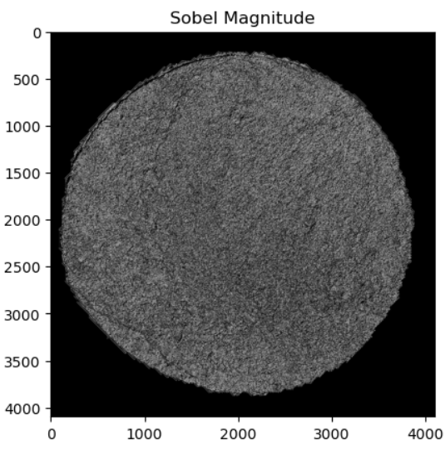
Full sobel on both x axis and y axis

Slide 31
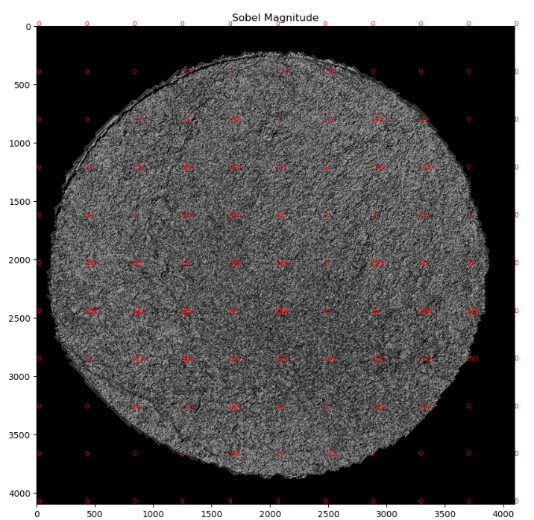
pixel range between 0-255 after sobel

Slide 32
Here is the slide window step, which was explained in slides 11-12.

Slide 33
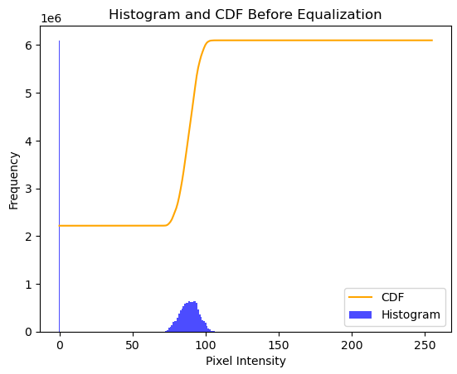
Histogram before equalization

Slide 34
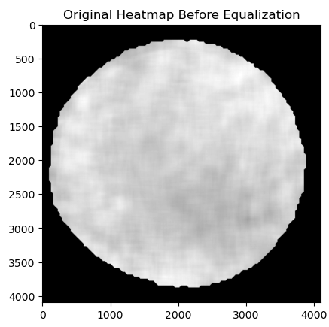
Before equalization and after sliding window

Slide 35
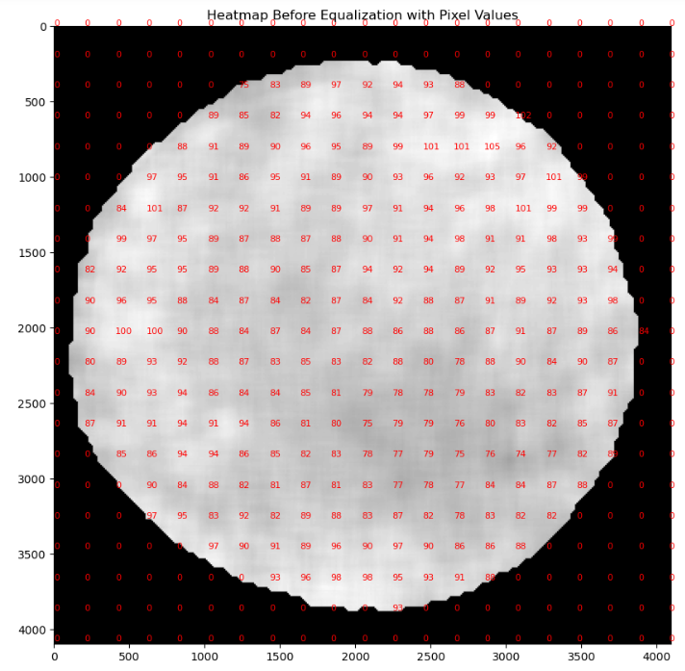

Slide 36
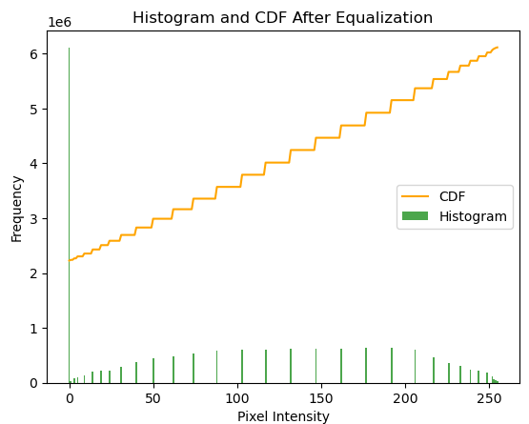
Histogram after equalization

Slide 37
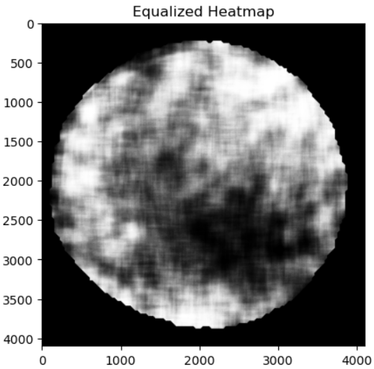
After Histogram equalization

Slide 38
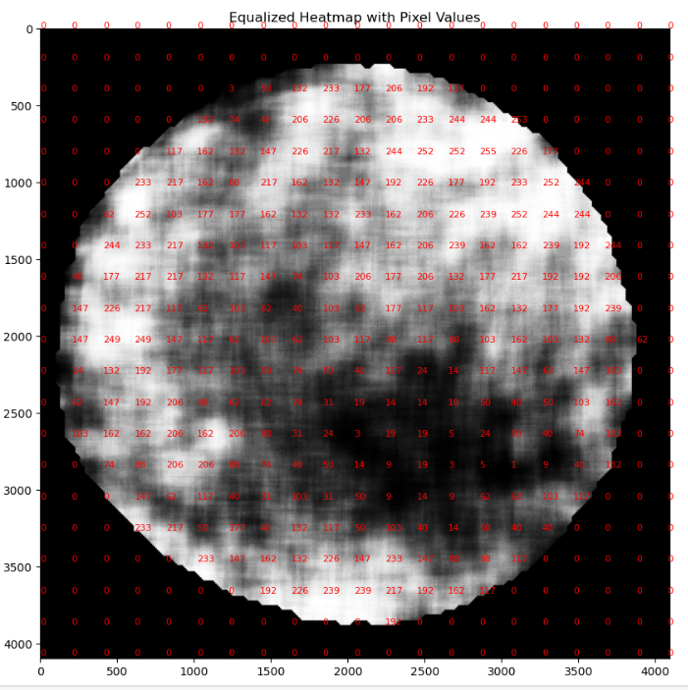

Slide 39
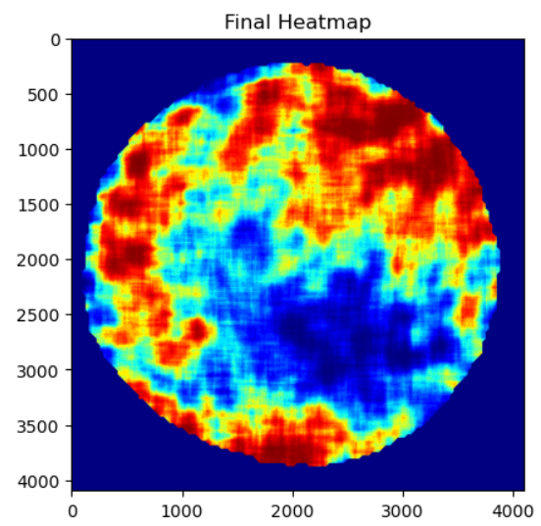
Final Heatmap

